Slide 1

Linear Regression
MTH 564 – Mathematical Modeling

Slide 2
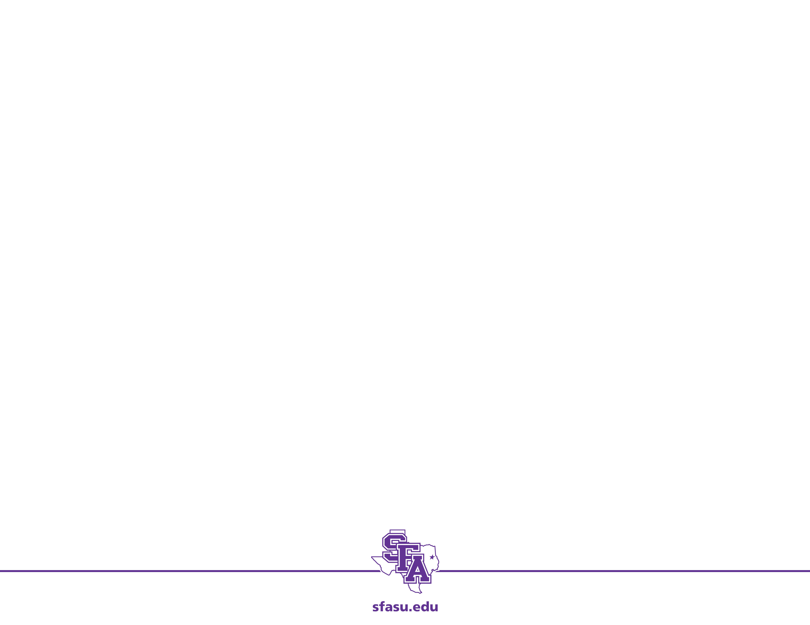
Problem
Adjustable-rate mortgages on private homes are commonly based on one of several market indices tabulated by the federal home loan bank. The author’s mortgage is adjusted yearly on the basis of the U.S. Treasury one-year Constant Maturity (CM1) index for May of each year. Historical data for the three-year period beginning June 1986 are shown in Table 8.1. Use this information to project the estimated value of this index in May 1990, the date of the next adjustment.

Slide 3
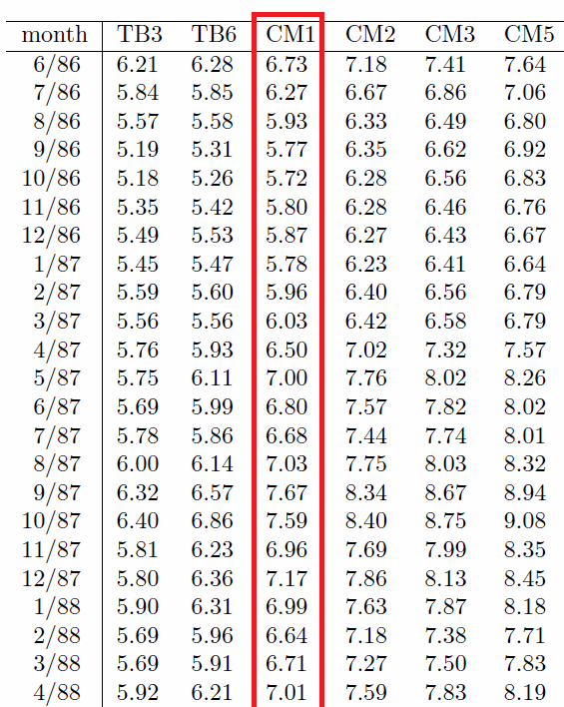
Data
The data can be found in the file cm1.csv
csv – comma separated values
We read the data into Python using the python panda package and the command read_csv
see linear_regression.py

Slide 4
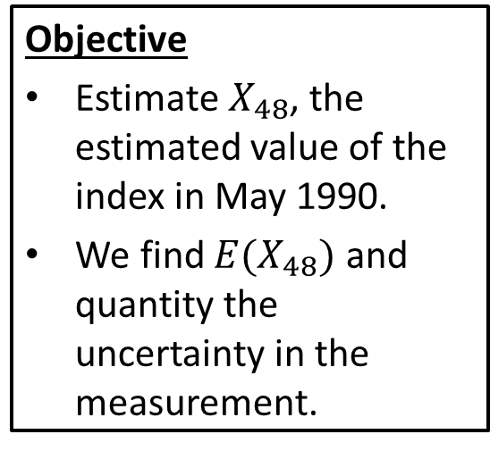
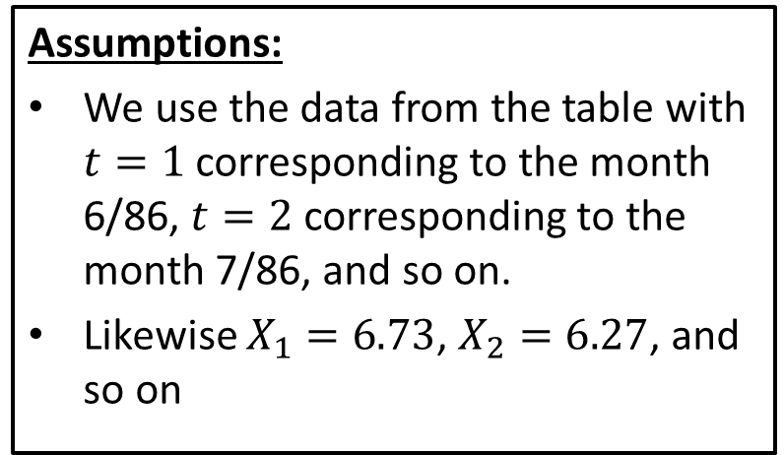
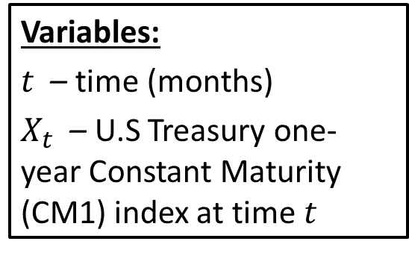
Step 1: Frame the problem
Variables:
$t$ – time (months)
$X_{t}$ – U.S Treasury one-year Constant Maturity (CM1) index at time $t$
Assumptions:
We use the data from the table with $t=1$ corresponding to the month 6/86, $t=2$ corresponding to the month 7/86, and so on.
Likewise $X_{1}=6.73$, $X_{2}=6.27$, and so on
Objective
Estimate $X_{48}$, the estimated value of the index in May 1990.
We find $E(X_{48})$ and quantity the uncertainty in the measurement.

Slide 5
Step 2: Select the modeling approach
Variables:
$t$ – time (months)
$X_{t}$ – U.S Treasury one-year Constant Maturity (CM1) index at time $t$
Assumptions:
We use the data from the table with $t=1$ corresponding to the month 6/86, $t=2$ corresponding to the month 7/86, and so on.
Likewise $X_{1}=6.73$, $X_{2}=6.27$, and so on
Objective
Estimate $X_{48}$, the estimated value of the index in May 1990.
We find $E(X_{48})$ and quantity the uncertainty in the measurement.
We model this problem using ordinary least squares (OLS) linear regression.

Slide 6
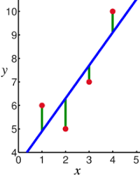



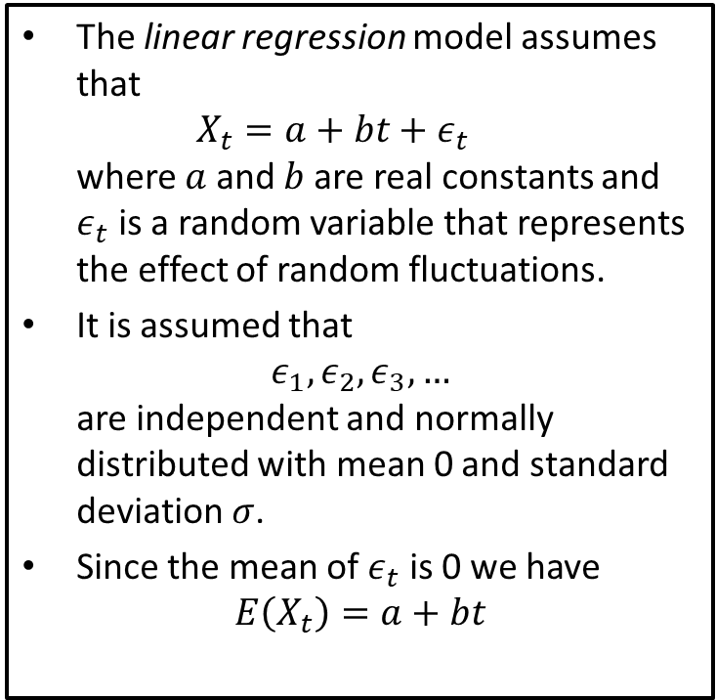
Linear Regression
The linear regression model assumes that $X_{t}=a+bt+ε_{t}$ where $a$ and $b$ are real constants and $ε_{t}$ is a random variable that represents the effect of random fluctuations.
It is assumed that $ε_{1},ε_{2},ε_{3}, …$ are independent and normally distributed with mean 0 and standard deviation $σ$.
Since the mean of $ε_{t}$ is 0 we have $E\left(X_{t}\right)=a+bt$
$$X_{t}$$
$$ε_{t}$$
$$t$$

Slide 7
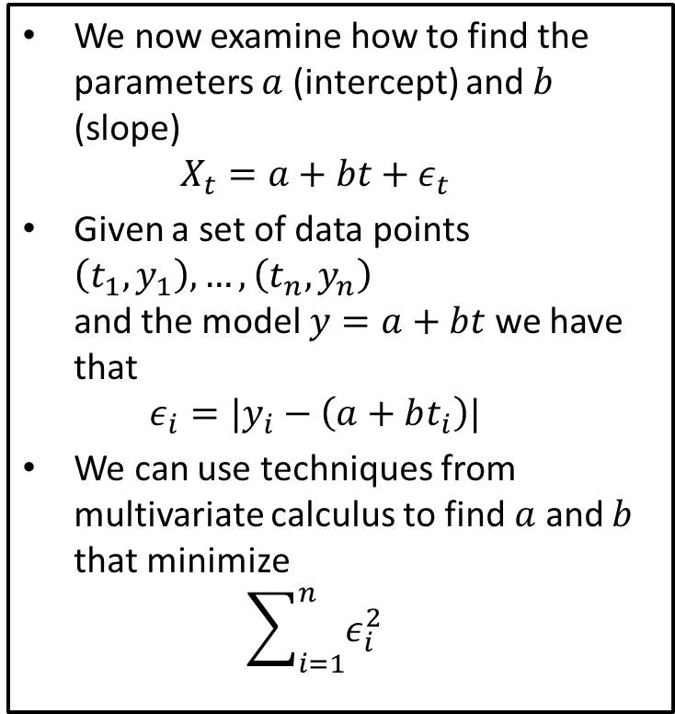
Linear Regression
We now examine how to find the parameters $a$ (intercept) and $b$ (slope) $X_{t}=a+bt+ε_{t}$
Given a set of data points $\left(t_{1},y_{1}\right), …, \left(t_{n},y_{n}\right)$ and the model $y=a+bt$ we have that $ε_{i}=|y_{i}−\left(a+bt_{i}\right)|$
We can use techniques from multivariate calculus to find $a$ and $b$ that minimize $\sum_{i=1}^{n}{ε_{i}^{2}}$
$$X_{t}$$
$$ε_{t}$$
$$t$$

Slide 8
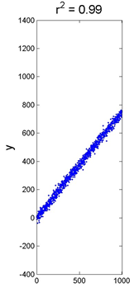
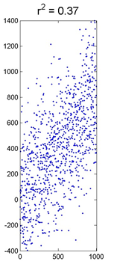
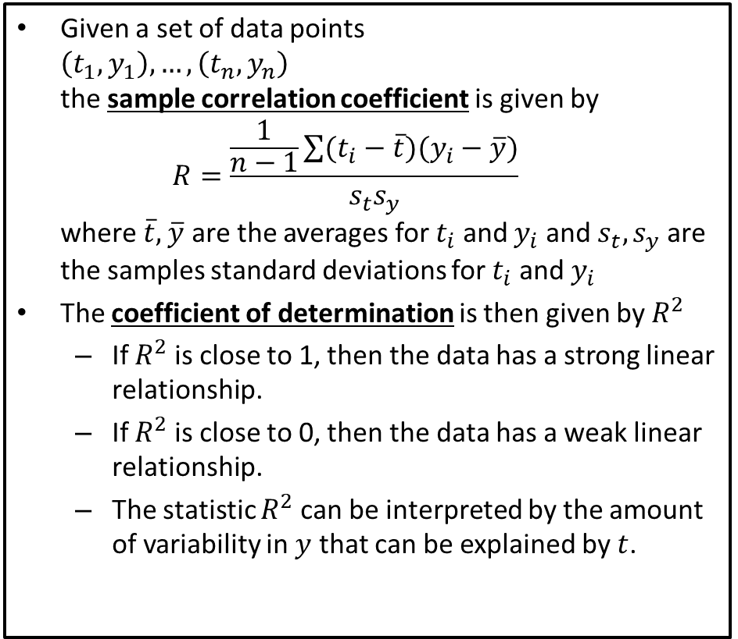
Coefficient of Determination
Given a set of data points $\left(t_{1},y_{1}\right), …, \left(t_{n},y_{n}\right)$ the sample correlation coefficient is given by $R=\frac{\frac{1}{n−1}\sum{(t_{i}−\overline{t})(y_{i}−\overline{y})}}{s_{t}s_{y}}$ where$\overline{t},$ $\overline{y}$ are the averages for $t_{i}$ and $y_{i}$ and $s_{t}, s_{y}$ are the samples standard deviations for $t_{i}$ and $y_{i}$
The coefficient of determination is then given by $R^{2}$
If $R^{2}$ is close to 1, then the data has a strong linear relationship.
If $R^{2}$ is close to 0, then the data has a weak linear relationship.
The statistic $R^{2}$ can be interpreted by the amount of variability in $y$ that can be explained by $t$.

Slide 9
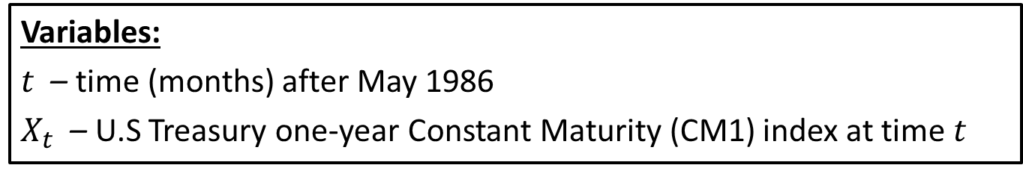
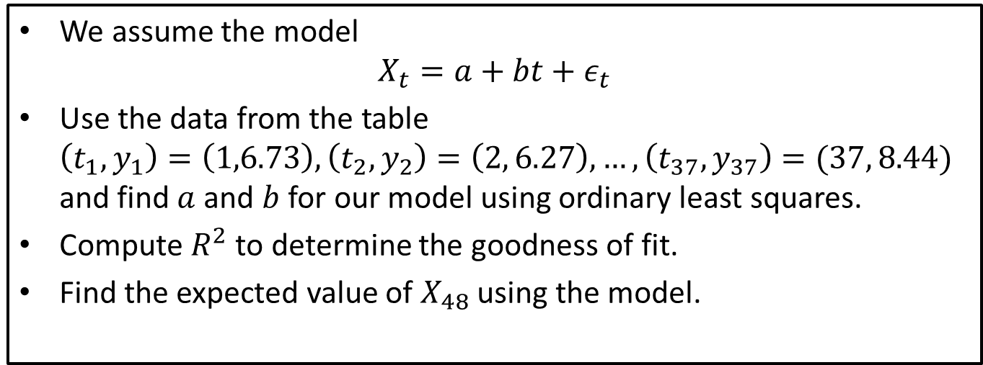
Step 3: Formulate the model
Variables:
$t$ – time (months) after May 1986
$X_{t}$ – U.S Treasury one-year Constant Maturity (CM1) index at time $t$
We assume the model $X_{t}=a+bt+ε_{t}$
Use the data from the table $\left(t_{1},y_{1}\right)=\left(1,6.73\right), \left(t_{2},y_{2}\right)=\left(2, 6.27\right), …, \left(t_{37},y_{37}\right)=(37, 8.44)$ and find $a$ and $b$ for our model using ordinary least squares.
Compute $R^{2}$ to determine the goodness of fit.
Find the expected value of $X_{48}$ using the model.

Slide 10
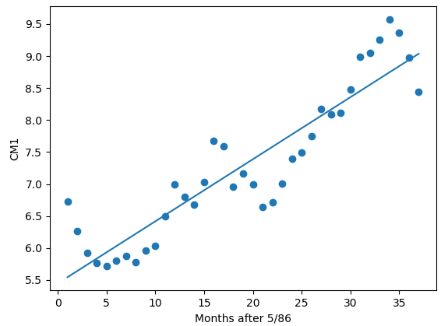
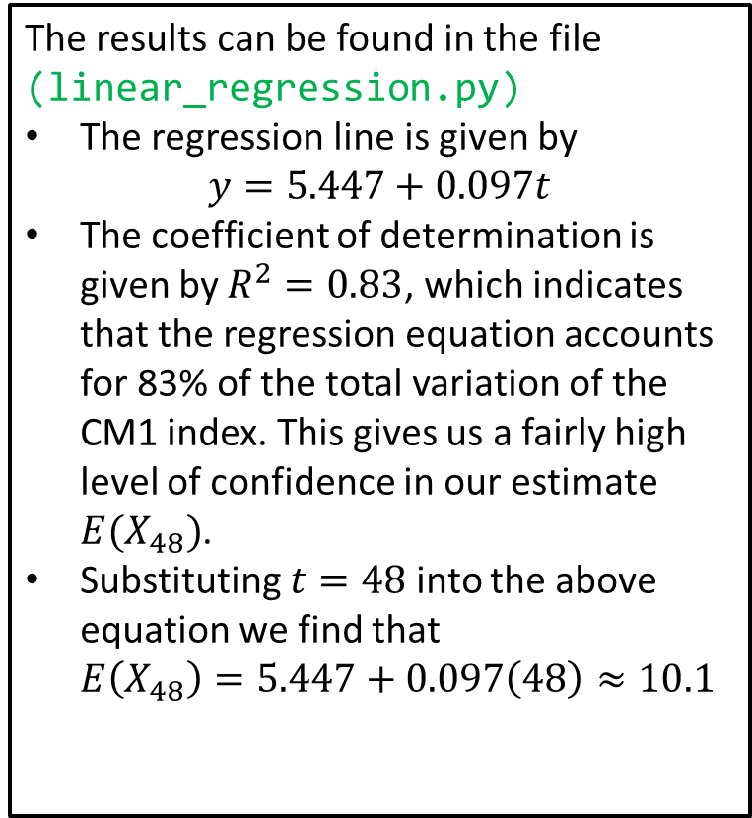
Step 4: Solve the Problem
The results can be found in the file (linear_regression.py)
The regression line is given by $y=5.447+0.097t$
The coefficient of determination is given by $R^{2}=0.83$, which indicates that the regression equation accounts for 83% of the total variation of the CM1 index. This gives us a fairly high level of confidence in our estimate $E(X_{48})$.
Substituting $t=48$ into the above equation we find that $E\left(X_{48}\right)=5.447+0.097\left(48\right)≈10.1$
Notes:
See python file section1-1pig.py

Slide 11
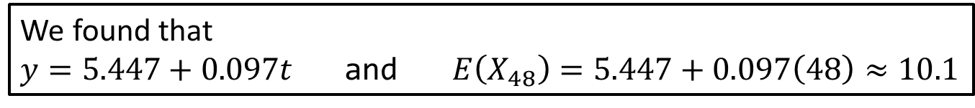
Step 5: Answer the question
We found that
$y=5.447+0.097t$ and $E\left(X_{48}\right)=5.447+0.097\left(48\right)≈10.1$
We have concluded that the CM1 index shows a general trend, increasing by about 0.097 points per month. This figure is based on historical data over the past three years.
Projecting on this basis, we obtain the estimate of 10.1 for the May 1990 index figure.
This is about 1.1 points higher than the May 1989 index, so in 1990 we should expect ARM payments to increase again.
Notes:
See python file section1-1pig.py

Slide 12
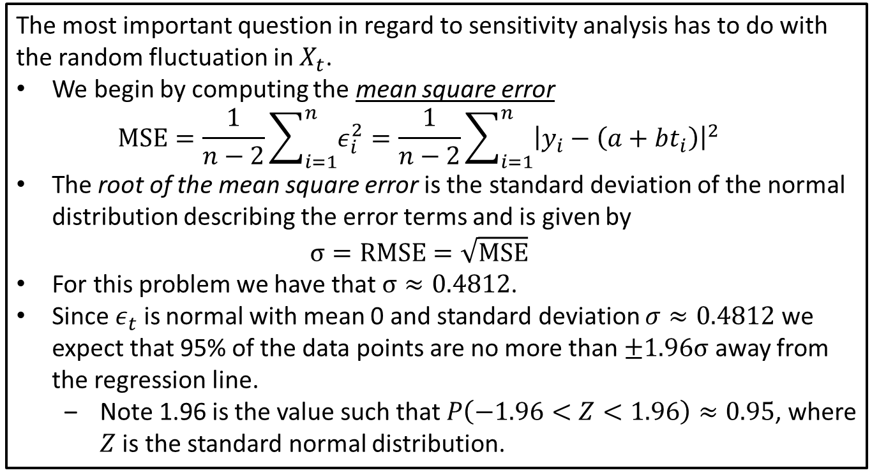
Sensitivity Analysis: Random Fluctuation
The most important question in regard to sensitivity analysis has to do with the random fluctuation in $X_{t}$.
We begin by computing the mean square error $MSE=\frac{1}{n−2}\sum_{i=1}^{n}{ε_{i}^{2}}=\frac{1}{n−2}\sum_{i=1}^{n}{{\left|y_{i}−\left(a+bt_{i}\right)\right|}^{2}}$
The root of the mean square error is the standard deviation of the normal distribution describing the error terms and is given by $σ=RMSE=\sqrt{MSE}$
For this problem we have that $σ≈0.4812$.
Since $ε_{t}$ is normal with mean 0 and standard deviation $σ≈0.4812$ we expect that 95% of the data points are no more than $±1.96σ$ away from the regression line.
Note 1.96 is the value such that $P\left(−1.96<Z<1.96\right)≈0.95$, where $Z$ is the standard normal distribution.
Notes:
See python file section1-1pig.py

Slide 13
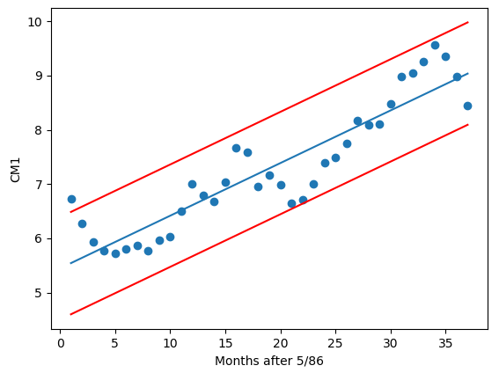
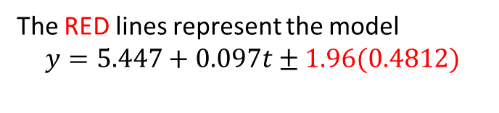
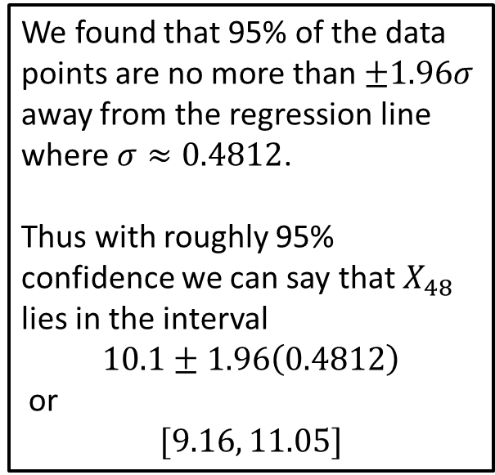
Sensitivity Analysis: Random Fluctuations
We found that 95% of the data points are no more than $±1.96σ$ away from the regression line where $σ≈0.4812$.
Thus with roughly 95% confidence we can say that $X_{48}$ lies in the interval
$$10.1±1.96\left(0.4812\right)$$
or
$$[9.16, 11.05]$$
The RED lines represent the model $$y=5.447+0.097t±1.96(0.4812)$$
Notes:
See python file section1-1pig.py

Slide 14
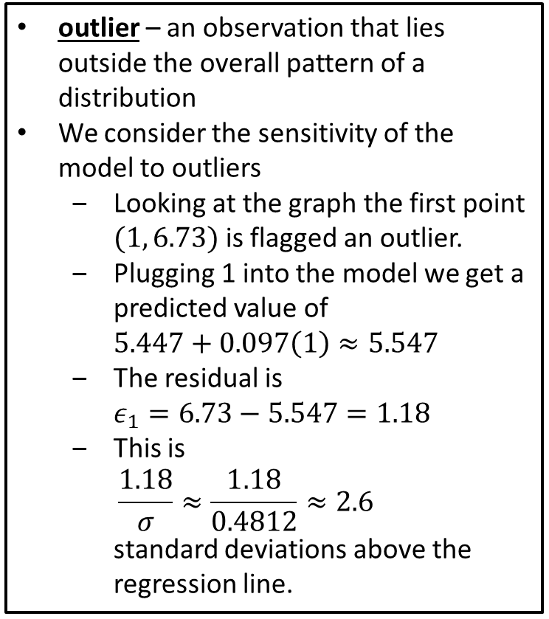
Sensitivity Analysis: Outliers
outlier – an observation that lies outside the overall pattern of a distribution
We consider the sensitivity of the model to outliers
Looking at the graph the first point $(1, 6.73)$ is flagged an outlier.
Plugging 1 into the model we get a predicted value of $5.447+0.097\left(1\right)≈5.547$
The residual is $ε_{1}=6.73−5.547=1.18$
This is $\frac{1.18}{σ}≈\frac{1.18}{0.4812}≈2.6$ standard deviations above the regression line.

Slide 15
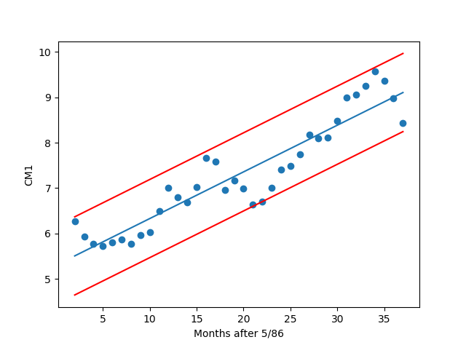
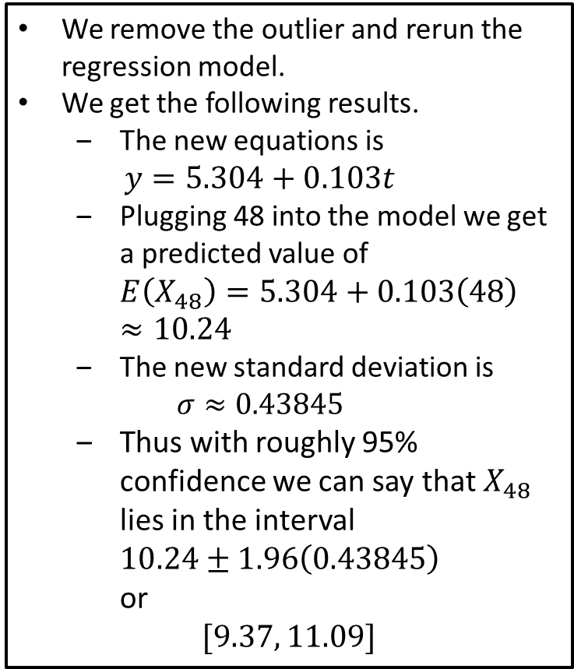
Sensitivity Analysis: Outliers
We remove the outlier and rerun the regression model.
We get the following results.
The new equations is $y=5.304+0.103t$
Plugging 48 into the model we get a predicted value of $E\left(X_{48}\right)=5.304+0.103\left(48\right)≈10.24$
The new standard deviation is $σ≈0.43845$
Thus with roughly 95% confidence we can say that $X_{48}$ lies in the interval $10.24±1.96\left(0.43845\right)$ or
$$[9.37, 11.09]$$

Slide 16
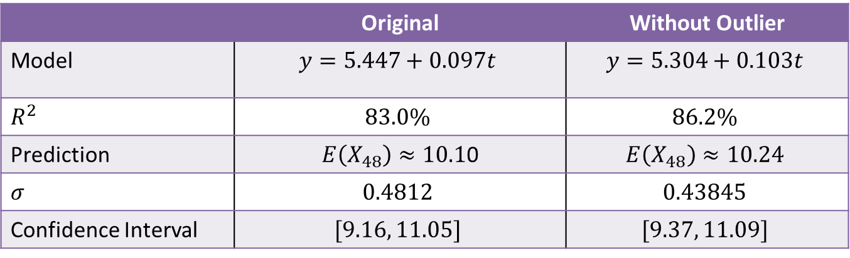
Sensitivity Analysis: Outliers
Comparing the original model to the new model without the outlier we get the following results.
 | Original | Without Outlier
Model | $$y=5.447+0.097t$$ | $$y=5.304+0.103t$$
$R^{2}$ | $$83.0\%$$ | $$86.2\%$$
Prediction | $E\left(X_{48}\right)≈10.1$0 | $$E\left(X_{48}\right)≈10.24$$
$σ$ | $$0.4812$$ | $$0.43845$$
Confidence Interval | $$[9.16, 11.05]$$ | $$[9.37, 11.09]$$
Conclusion: The values are not very sensitive to the outlier.

Slide 17
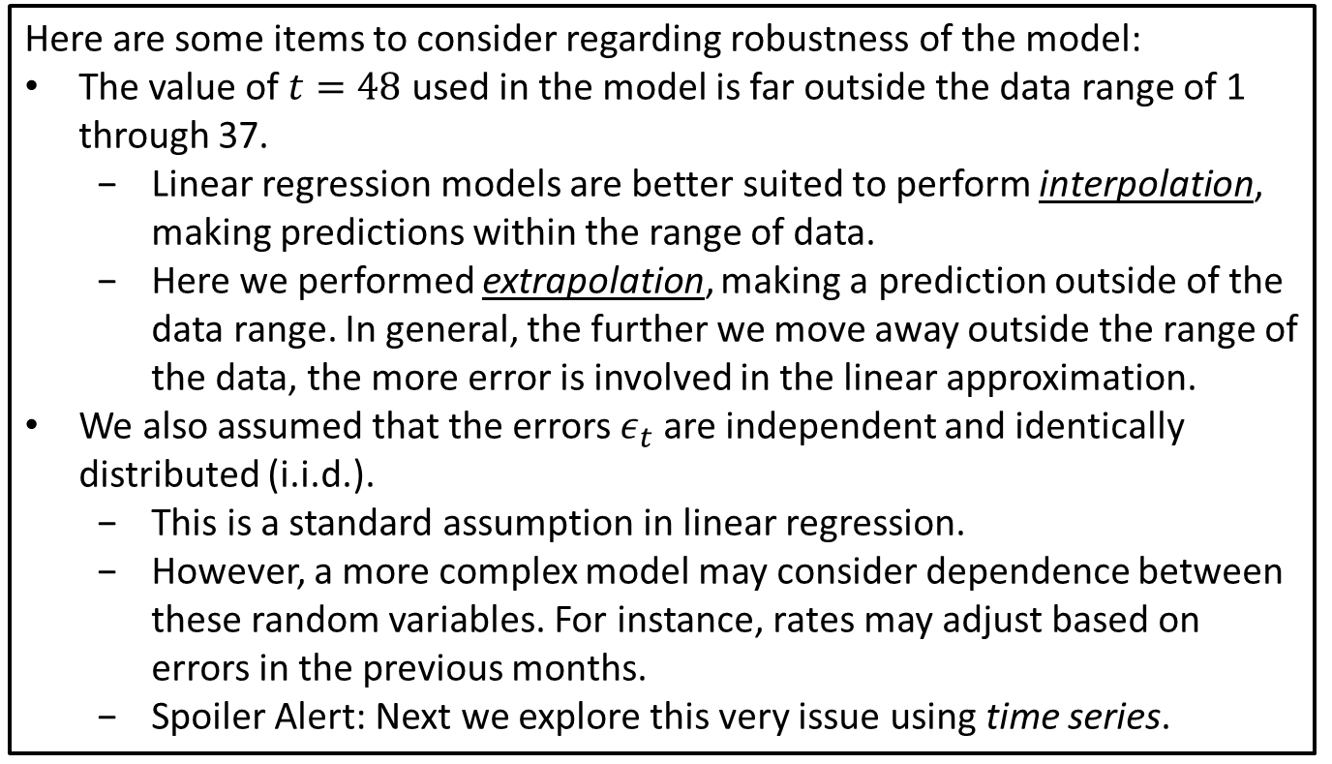
Robustness
Here are some items to consider regarding robustness of the model:
The value of $t=48$ used in the model is far outside the data range of 1 through 37.
Linear regression models are better suited to perform interpolation, making predictions within the range of data.
Here we performed extrapolation, making a prediction outside of the data range. In general, the further we move away outside the range of the data, the more error is involved in the linear approximation.
We also assumed that the errors $ε_{t}$ are independent and identically distributed (i.i.d.).
This is a standard assumption in linear regression.
However, a more complex model may consider dependence between these random variables. For instance, rates may adjust based on errors in the previous months.
Spoiler Alert: Next we explore this very issue using time series.
Notes:
See python file section1-1pig.py

